Slide 1
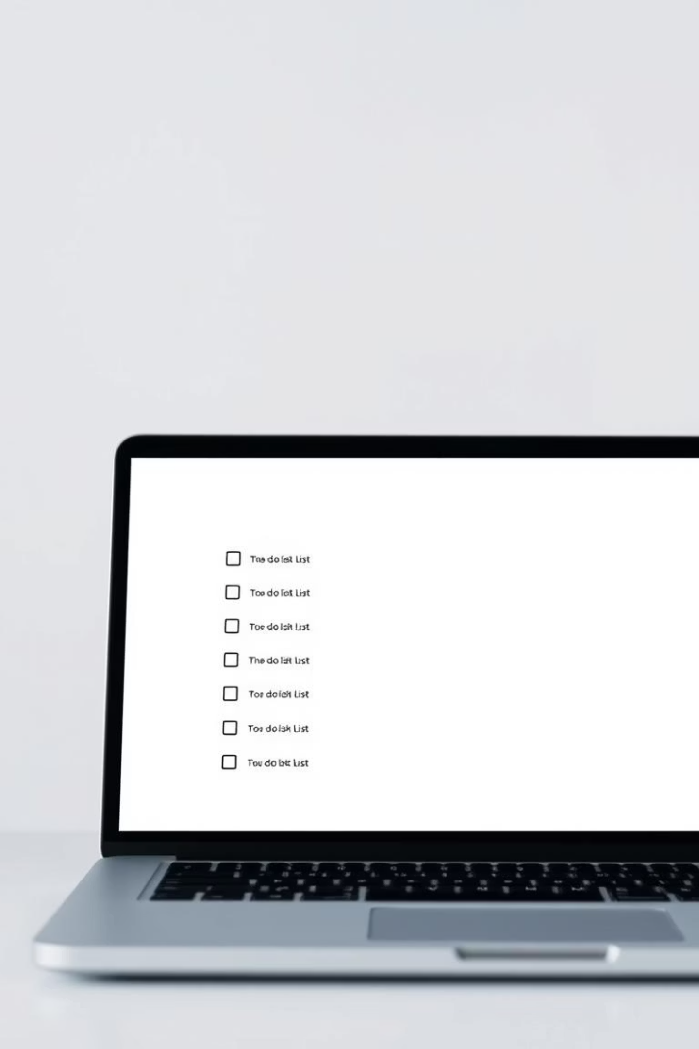
Internship Project: My To-Do List Application
Welcome to my presentation on the To-Do List Application I developed during my internship.

Slide 2
The Problem
My Goal
Busy schedules and scattered notes often lead to forgotten tasks and missed deadlines. We all need a better way to stay organized.
To create an intuitive, efficient, and user-friendly application that helps individuals manage their daily tasks effortlessly.

Slide 3




Task Management
Mark as Complete
Add, edit, and delete tasks with ease, keeping your list always up to date.
Simple one-click completion for satisfying task accomplishment.
Due Dates
Filtering Options
Assign deadlines to tasks to help prioritize and meet goals.
Quickly find tasks by status (e.g., pending, completed) or due date.

Slide 4
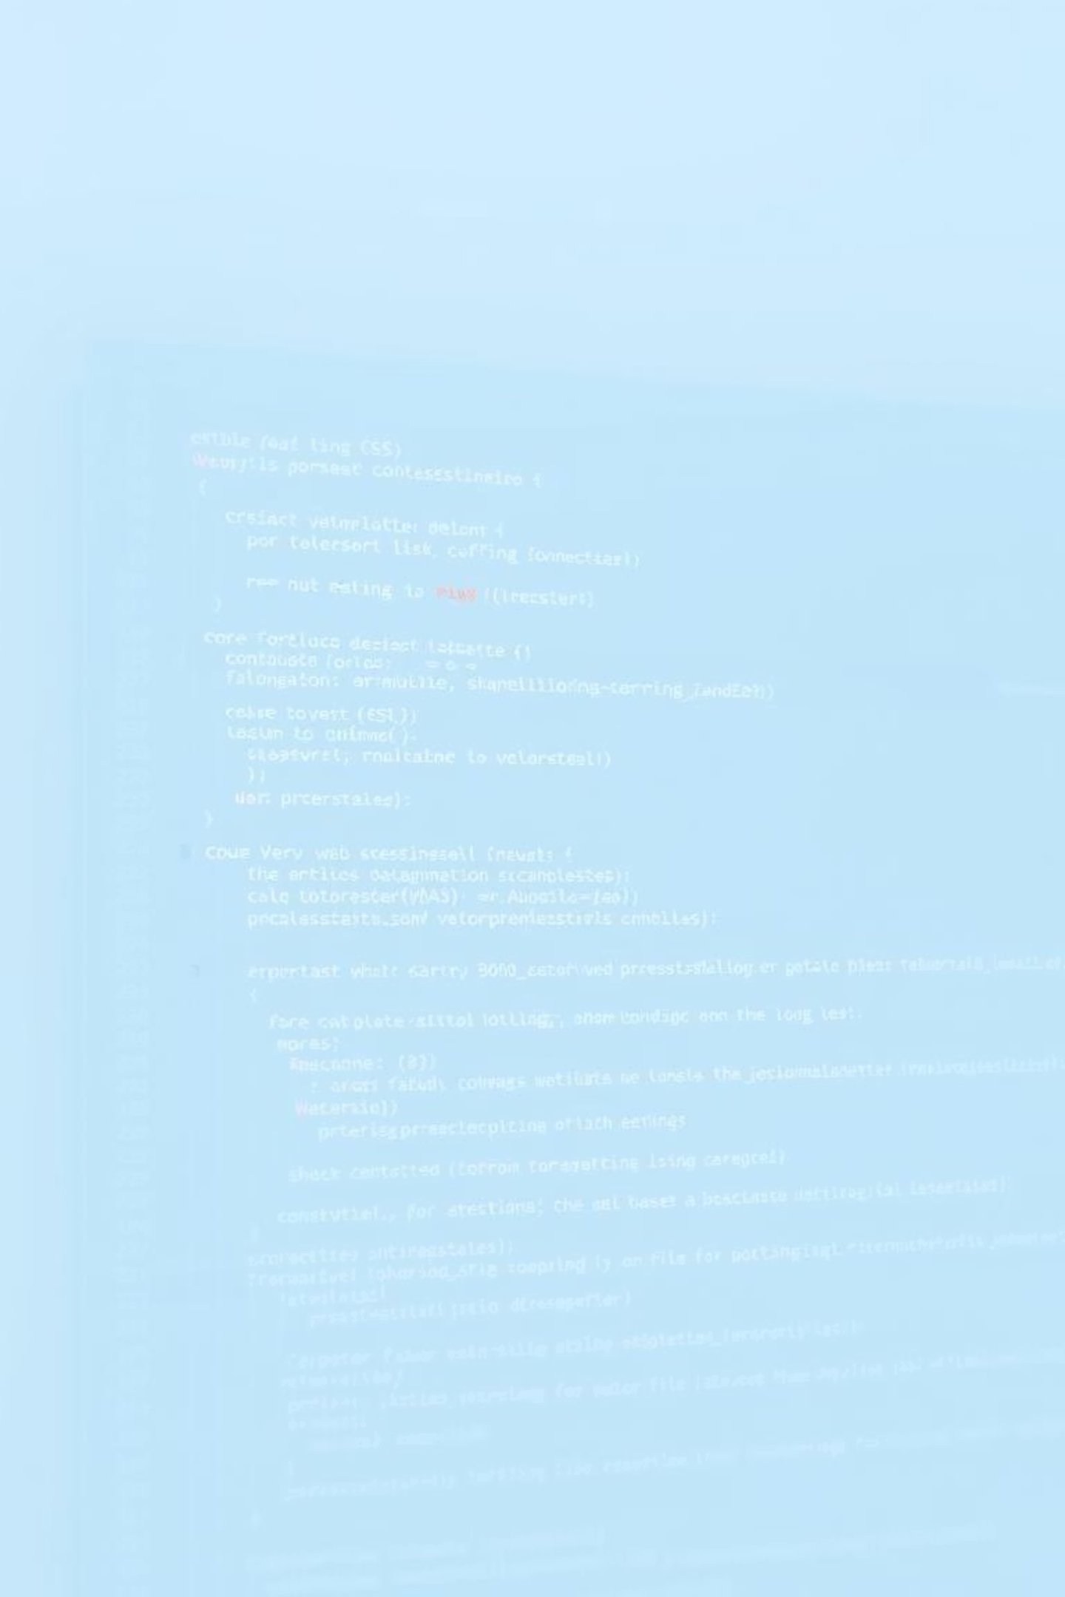
Front-End
Back-End & Database
HTML: Structures the application's content.
Local Storage: Stores tasks directly in the browser.
CSS: Styles the visual design for a clean look.
No Server: Keeps the application lightweight and fast.
JavaScript: Handles all interactive elements and logic.

Slide 5
Persistence & Data Handling
User Experience Design
Initial Setup
Ensuring an intuitive interface for seamless task management.
Implementing local storage to save tasks, even after closing the browser.
Setting up the project environment and understanding the core requirements.

Slide 6



Problem-Solving
Coding Best Practices
Independent Work
Tackling unexpected bugs and finding effective solutions reinforced my debugging skills.
Learning to write clean, modular, and efficient code for better maintainability.
Gaining confidence in developing a complete application from concept to execution.

Slide 7
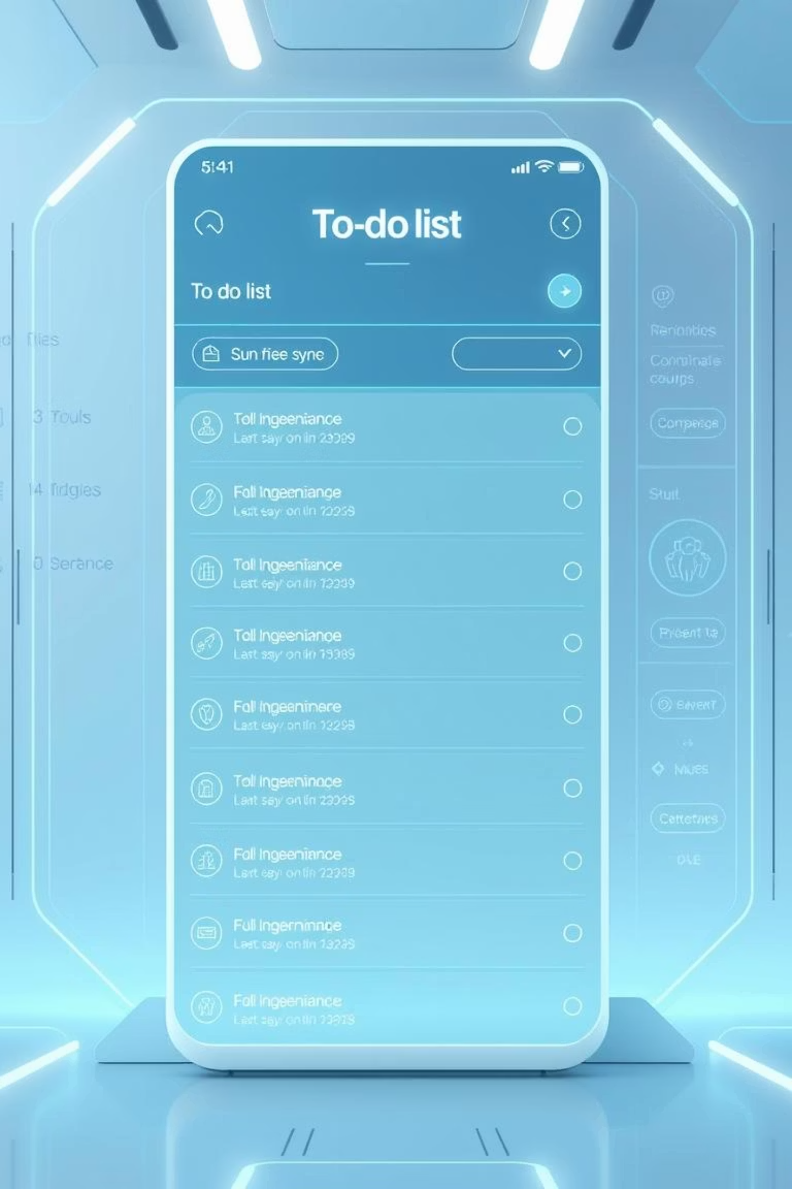
Cloud Sync
Reminders
Categorization
Voice Input
Sync tasks across multiple devices via a cloud database.
Add notifications for upcoming deadlines.
Organize tasks into categories or projects.
Add tasks using voice commands for convenience.

Slide 8
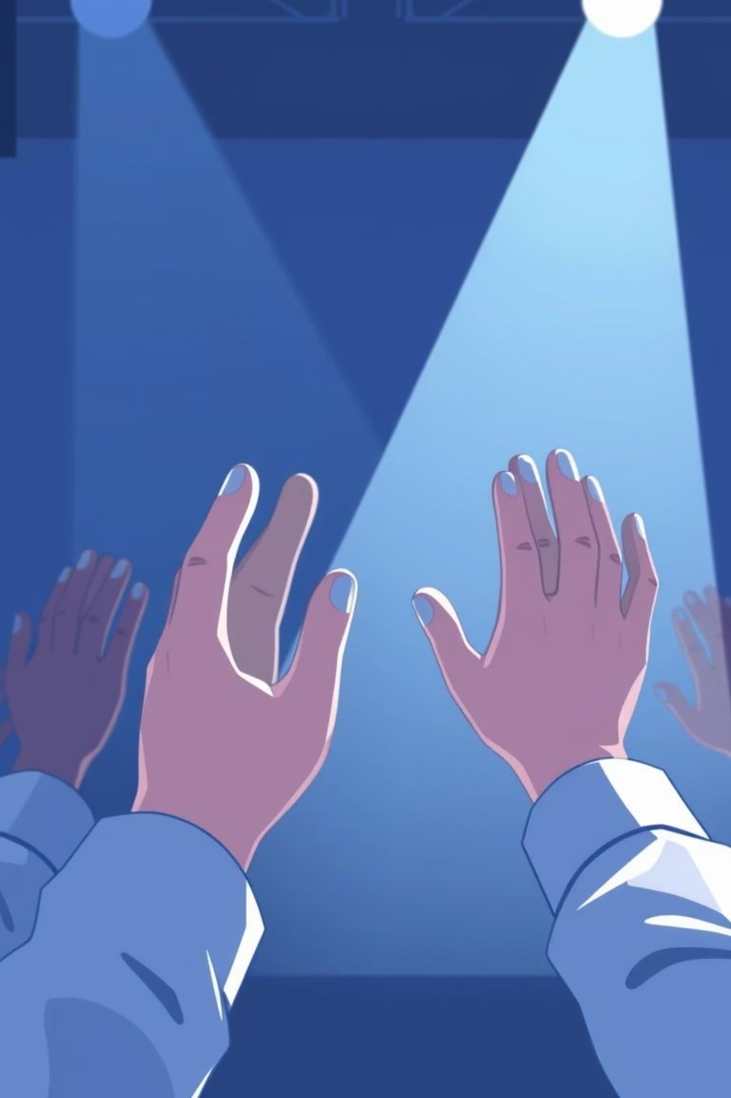
Thank You
I appreciate your time and attention. I'm happy to answer any questions you may have about the project!

